Slide 1
Building Operational Resiliency
A case study of Risk Management of Nissan
Presenter:
Wang Guozhi
Xiao Qiwen
Notes:
大家晚上好，我们组今天要present的case是一篇关于尼桑汽车有限公司，也就是Nissan Motor Company Ltd.的风险管理案例分析。我们组有我王国智还有肖淇文同学为大家展示。

Slide 2
Content
Introduction of Nissan
Risk Analysis
Risk Assessment
Discussions
Notes:
我们的展示分成四个部分，分别是尼桑公司的介绍，尼桑遇到的风险，尼桑公司的风险评估措施，和案例的讨论。由我讲述前两部分，淇文同学讲述后两部分。

Slide 3
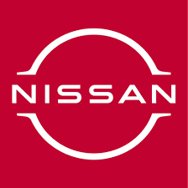
Introduction of Nissan
Notes:
首先，尼桑公司的介绍。尼桑公司在中国的名字叫做日产，从这个名字也能看出，尼桑汽车进入中国市场毫不避讳自己的身份来自日本。我们介绍的这篇案例是2013年发布的，所以这次presentation我们也重点关注在2013年之前的尼桑，是怎么发展的。

Slide 4

History of Nissan
Pre-1930s
1933
Post-WWII
1950s-1960s
1970s
1980s
Post-1985
Continued global expansion.
Limited to military and imported kits.
Founding by Aikawa Yoshisuke.
Rescued by government loans and US Army orders.
Shift to internal R&D.
Adoption of just-in-time manufacturing.
Increased production, exports, and North American facilities.
2000s
Alliance with Renault in 1999 enhanced global market reach.
2010s
Implemented robust risk management practices.
Notes:
可以看到图片梳理的时间线，我们从左上角，1930年之前来看起。那时日本车企，包括尼桑，还受限于军事订单和进口零部件，并没有自己的制造汽车的能力。在1933年，日本汽车走向大生产的大趋势下，尼桑也在这时成立。在二战之后，尼桑由于自己的产能底下，濒临破产，还是在日本政府的贷款和美国军队的订单下才得救。在接下来的50年代到80年代，尼桑进行了一系列的战略转型，从最初的重度依赖美国的技术转移，到发展自己的R&D研究与发展战略，到80年代的大量出口，尼桑和其他日本车企慢慢走向了全球化的战略格局。直到90年代的日本经济危机，尼桑又一次陷入破产的泥潭，最后靠着和法国雷诺的联盟，得到雷诺的支持才得与喘息，并且在08年全球经济危机时吸取前车之鉴，在Nissan特色的风险管理策略中度过了那段时期。

Slide 5
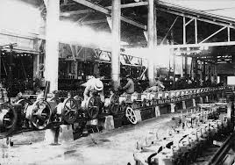
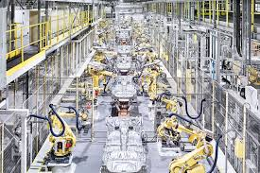
History of Nissan
Old Streamline factory
New Streamline factory
Notes:
在这张图就可以看到，尼桑的流水线走过了一个世纪的发展，已经变得非常成熟和高效了。

Slide 6
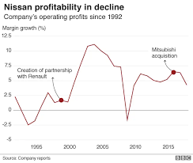
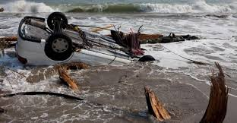
Risk Analysis Financial Crisis and Disaster
Notes:
介绍完尼桑的历史发展，我们就来看看尼桑在发展过程中遇到的风险到底有哪些，不仅有人祸，也就是经济危机，也有天灾。

Slide 7
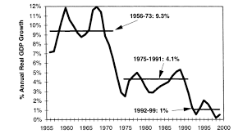
Late 1990s Financial Crisis
Overview of the Crisis:
Japan's "Lost Decade" economic stagnation.
Severe impact on the automotive industry.
Impact on Nissan:
Significant financial losses and debt.
Operational inefficiencies and outdated processes.
Complex product lines increased costs.
Declining market share.
Figure source: https://merchantsandmechanics.com/2017/04/15/an-economic-history-of-postwar-japan/
Notes:
首先是尼桑遇到的90年代后期的经济危机，那一段时间呗称为日本失落的十年，对日本经济造成了极大的影响，也对汽车行业造成了很大的影响。从图中就可以看到，日本经济的实际GDP增长率，从二战后的9%左右，到七八十年代的4%左右，到90年代的经济危机已经降到了1%。对于尼桑来说，这次经济危机不仅给尼桑债台高筑，它自身的运营问题和商业过程也得不到发展。

Slide 8
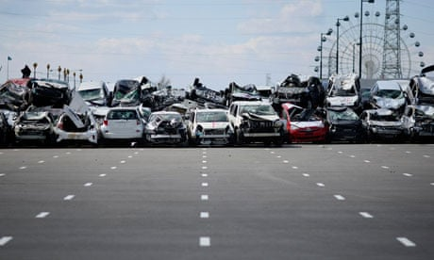
2011 Japan Earthquake
Overview of the Disaster:
9.0 magnitude earthquake and tsunami.
Significant infrastructure damage.
Impact on Nissan:
Facility damage and supply chain disruption.
Temporary production halts.
Figure source: https://www.theguardian.com/business/2011/apr/20/japanese-disasters-cause-fall-in-exports
Notes:
到2011年，日本发生了9级大地震，与连带并发的海啸一起狠狠冲击了日本。不仅造成了基础设施的破环，经济上也是一次巨大的冲击。对于尼桑来说一次巨大的冲击，不仅工厂的流水线被毁，生产终止，还殃及了供应链下游的订单交付。所以，尼桑在天灾人祸下，一次次巩固自己的风险管理，不仅没有被危机打垮，反而走到今天成为全球知名的汽车品牌。接下来我的队友将接着介绍尼桑的的风险评估。

Slide 9
Risk Assessment
Toyota Nissan Honda
Large size,
High rate of Japanese production
Several plants close to the disaster area
Production in the US but constraints in its supply chain
“... Most of the steps we have taken... have been continuations of strategies, priorities and plans that were already in place...”

Slide 10
Risk Assessment
Sharing information
“... each region was asked to send two staff members to Japan to gather their own information and to help solve problems holistically...”
Complete Visibility

Slide 11
Risk Assessment
Allocating supply
“... The sales, marketing, and the regional supply chain management functions were brought together to identify how to globally allocate supplies to focus on highest margin goods...”
High-end
high-margin models
Integrated GPS
Low-end
low-margin models
Completed within
2 weeks

Slide 12
Risk Assessment
Managing production
“... Management closely considered in-stock and in-transit inventory within their network and slowed production upstream and downstream of anticipated bottlenecks...”
Bottleneck production
Costly overtime
Free up capacity later in summer when upstream bottlenecks were projected to have cleared
Pulling vacation time into April and May

Slide 13
Risk Assessment
Managing production
“... Management closely considered in-stock and in-transit inventory within their network and slowed production upstream and downstream of anticipated bottlenecks...”
15 days
lead-time for ocean transport to the west coast of the US
5 days
to move materials to plants in Tennesse and Mississippi
20 days
to identify how to access alternative supplies of critical components

Slide 14
Risk Assessment
Managing production
“... Management closely considered in-stock and in-transit inventory within their network and slowed production upstream and downstream of anticipated bottlenecks...”
... secure air freight out of Japan to get critical parts out of the country faster and mitigate the reduction of in-transit stocks...

Slide 15
Risk Assessment
Empowering action
“... Management was empowered to make decisions in the field without lengthy analysis from a central authority...”
Launched Global Disaster Control Headquarters just
15 minutes
after the earthquake

Slide 16
Discussions
What else could Nissan have done to prepare for and respond to the disaster?
Diversify Supply Chain Locations
Example: Honda
Large localized U.S. production
Other Countries
Demand
Japan

Slide 17

Discussions
How will the operational changes announced in 2012 affect Nissan’s exposure to future disruptions?
1. Increase local production in the Americas
70%$→$90%
2. Reduce reliance on Japanese-made components in foreign factories
-50% (JP$→$NA)
3. Mitigate supply risk concentration for critical components

Slide 18
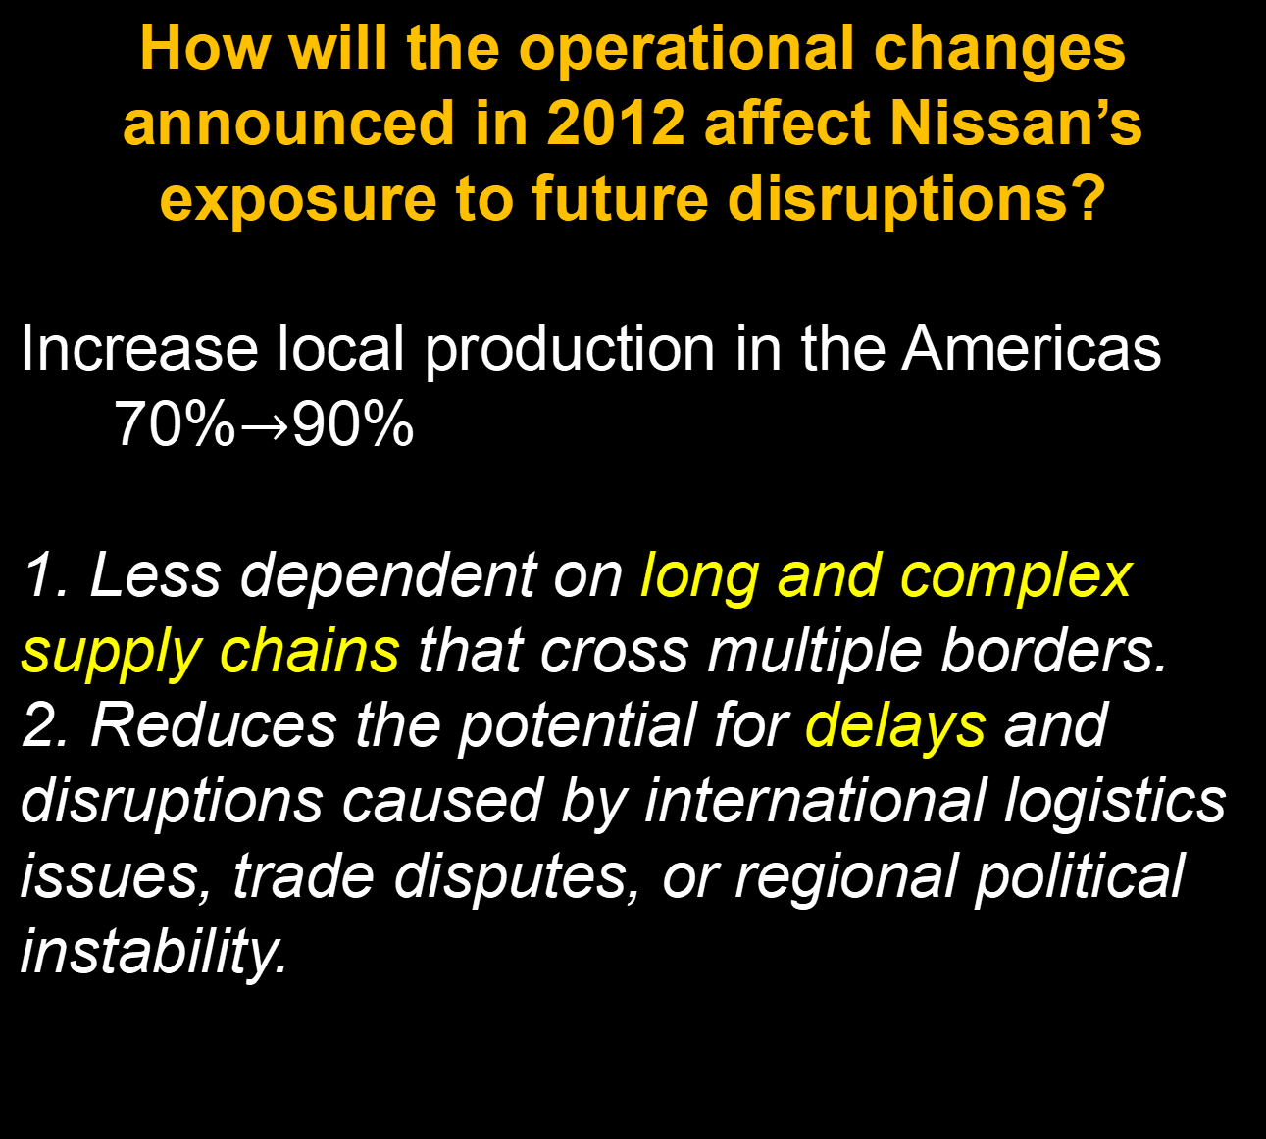
Discussions
How will the operational changes announced in 2012 affect Nissan’s exposure to future disruptions?
Increase local production in the Americas
70%$→$90%
1. Less dependent on long and complex supply chains that cross multiple borders.
2. Reduces the potential for delays and disruptions caused by international logistics issues, trade disputes, or regional political instability.

Slide 19
Discussions
How will the operational changes announced in 2012 affect Nissan’s exposure to future disruptions?
Reduce reliance on Japanese-made components in foreign factories
Encourages the development of a more diverse supplier base. With critical components sourced from multiple regions, the company can better manage supply risks and avoid bottlenecks if one supplier or region faces issues.

Slide 20
Discussions
How will the operational changes announced in 2012 affect Nissan’s exposure to future disruptions?
Mitigate supply risk concentration for critical components
Contingency plans in place for the most essential parts of its production process. Reduces the risk of production halts due to shortages of vital components.

Slide 21
Thank you!

